Slide 1
VDM-SL

Slide 2
VDM-SL
VDM is a “model-oriented approach”
An explicit model of the state of an abstract machine is given, and operations are defined in terms of this state.
Operations are defined in a precondition and postcondition style.
Each operation has an associated proof obligation to ensure that if the precondition is true, then the operation preserves the system invariant.
The initial state itself is, of course, required to satisfy the system invariant.

Slide 3
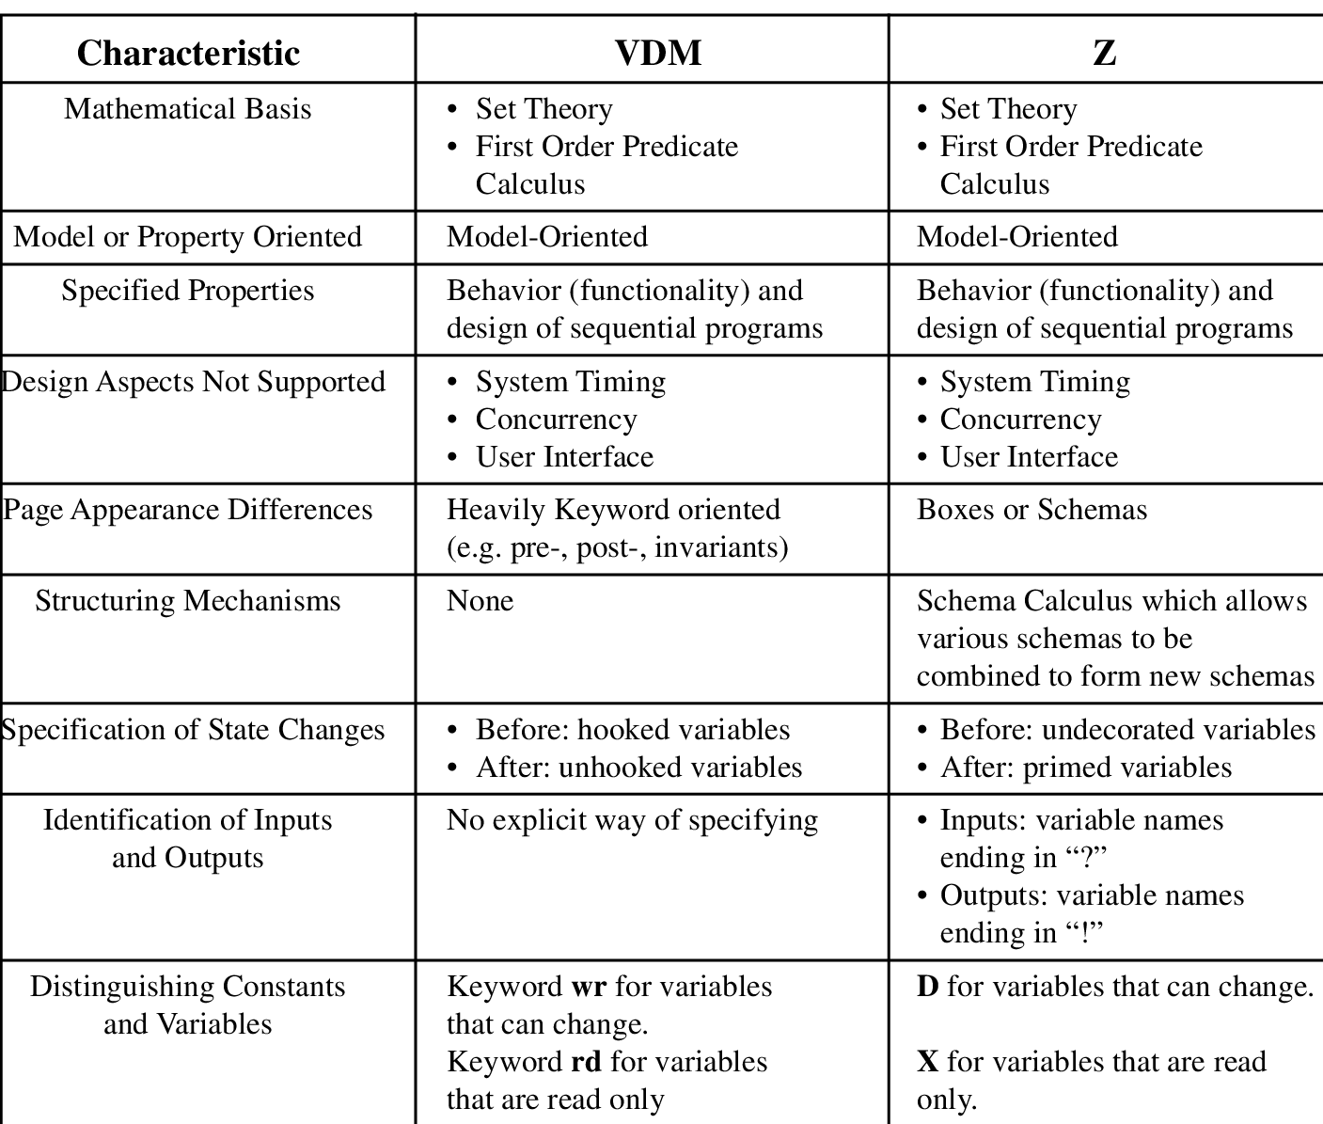
Comparative Analysis between VDM and Z

Slide 4
VDM-SL
A VDM specification consists of
Type definitions
State Definitions
Invariant for the system
Definition of the operations of the system

Slide 5
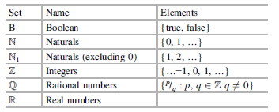
Built-in Types in VDM

Slide 6
Example
Consider a simple library system that allows borrowing and returning of books. The data types for the library system are first defined, and theoperation to borrow a book is then defined.
It is assumed that the state is made up of three sets, and these are the set of books on the shelf, the set of books which are borrowed, and the set of missing books.
These sets are mutually disjoint.
The effect of the operation to borrow a book is to remove the book from the set of books on the shelf and to add it to the set of borrowed books.

Slide 7
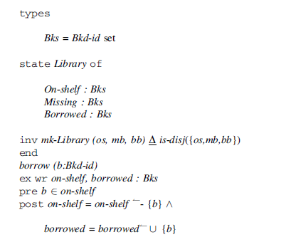
Example-Borrow Book-Library Management System
Notes:
Vdm-sl operation include
Header,external clause,pre,post

Slide 8
Example-Explanation
The notation Bkd-id set specifies that Bks is a set of Bkd-ids, e.g. Bks = {b1, b2,… bn}.
The invariant specifies the property that must remain true for the library system.
Borrow operation is defined using preconditions and postconditions.
The notation “ext wr” indicates that the borrow operation affects the state
The notation “ext rd” indicates an operation that does not affect the state.
Notes:
VDM is a widely used formal method and has been used in industrial strength
projects as well as by the academic community. These include security-critical
systems and safety critical sectors such as the railway industry

Slide 9
Sequences
Sequences are used frequently in VDM specifications.
A sequence is a collection of items that are ordered in a particular way.
Duplicate items are allowed for sequences, whereas duplicate elements are not meaningful for sets.

Slide 10

Sequences
A sequence of elements x1, x2, … xn is denoted by [x1, x2, … xn], and the empty sequence is denoted by [ ].
Given a set S, then S* denotes the set of all finite sequences constructed from the elements of S.
The length of a sequence is given by the len operator:

Slide 11

Sequences
The hd operation gives the first element of the sequence. It is applied to non-empty sequences only:

Slide 12

Sequences
The tl operation gives the remainder of a sequence after the first element of the sequence has been removed. It is applied to non-empty sequences only:

Slide 13

Sequences
The elems operation gives the elements of a sequence. It is applied to both empty and non-empty sequences:

Slide 14

Sequences
The idx operation is applied to both empty and non-empty sequences. It returns the set {1, 2, … n} where n is the number of elements in the sequence.

Slide 15

Sequence
Two sequences may be joined together by the concatenation operator:

Slide 16
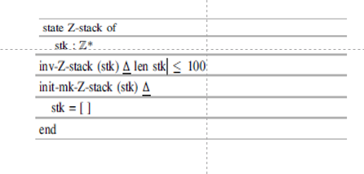
Specification For Stack of Integer
A stack of (up to 100) integers is specified as:

Slide 17
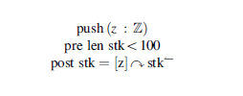
Push Operation
The push operation is then specified in terms of preconditions/postconditions as :

